Slide 1
Event Organisation Portal Using MEAN Stack
International Conference on Sustainable Computing and Data
Communication Systems ICSCDS-2022
Shree Venkateshwara Hi-Tech Engineering College Erode, India
Authors:
Rashmee Wadagave, Srushti Karoshi, Pranali Ravan, Rutuja Santikar, Rashmi Deshmukh
Presented By:
Rashmee Wadagave Paper ID: ICSCDS167

Slide 2
Overview
Abstract
Introduction
Related Work
Software Requirement
Proposed System
Conclusion
References

Slide 3
Abstract
One of the latest technology is MEAN Stack.
MEAN Stack contains components MongoDB, Express JS, Angular, Node JS
MEAN Stack is fast, scalable and gives notable results for a systematic web application.
“Event Organisation” portal is an institute level portal to maintain the connection between students and the institute.

Slide 4
Introduction
Using MEAN Stack web development is done more efficiently.
During the pandemic, everything was online including schools, colleges, universities.
“Event Organisation” allows students to interact with institutes with various activities.
This portal helps students gain knowledge with various features provided in the portal.
Some features are accessed to that institute and some are open to all.

Slide 5
Related Work
The main purpose of using MEAN stack was it rely on JavaScript on the server-side and typescript on the client-side.
This helps both client and server-side interact.
Angular: Angular is the next mean stack framework used for web development.
Node Js: Node Js is the next cross-platform, open-source runtime environment used for the development of networking and server-side applications.
Express Js: Express Js is one of the latest and widely used web frameworks in the Node.js environment. Express Js is a web server built on Node.js
MongoDB: MongoDB is simple and is used for storing databases. MongoDB is an open-source document database and a NoSQL database.

Slide 6
Software Requirement
Platform required - Windows NT platform OR Linux
Architectural requirement - Intel 32 bit processor
Interface - Graphical User Interface
IDE & Tools: Visual Studio Code
Installation - node, npm, Angular CLI, bootstrap, authentication guard (Auth Gaurd)
Server side installation- mongoose, JSON web token(JWT), body-parser, handlebars

Slide 7
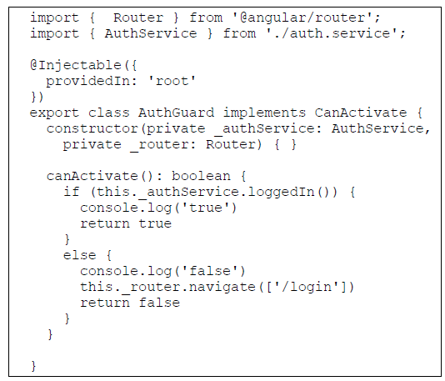
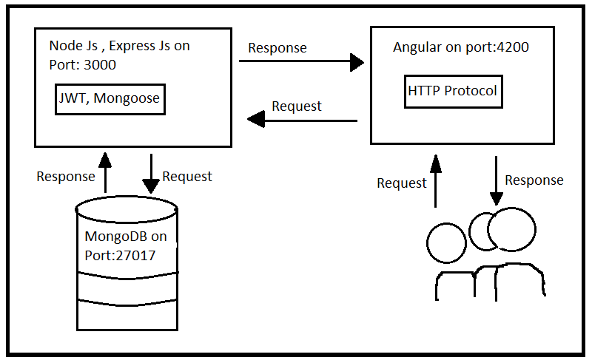
Proposed Systems
Architecture
Auth Guard on Client-side

Slide 8
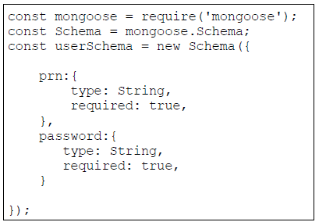
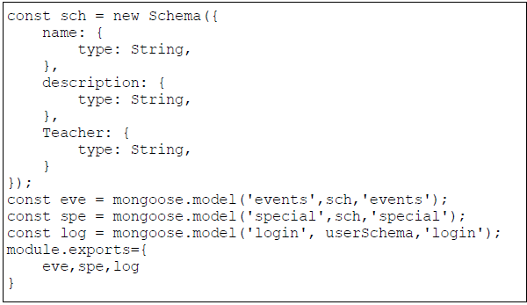
Schema

Slide 9
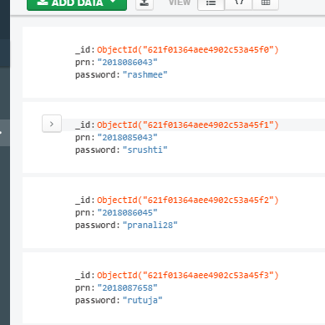
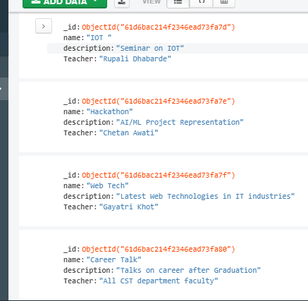
Data storage in MongoDB DataBase

Slide 10
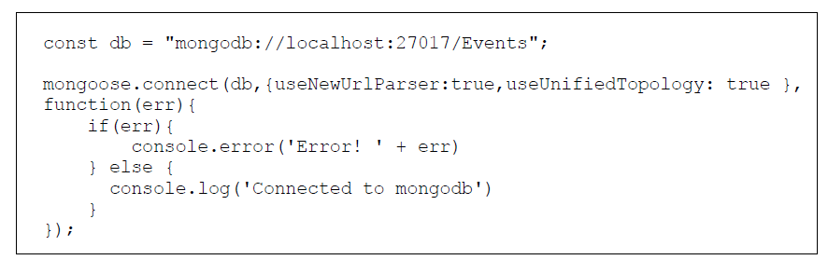
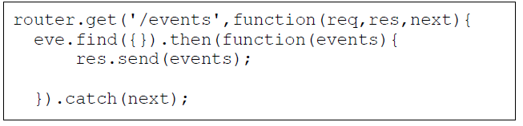
Connection of MongoDB to express Js and accessing data from DataBase

Slide 11
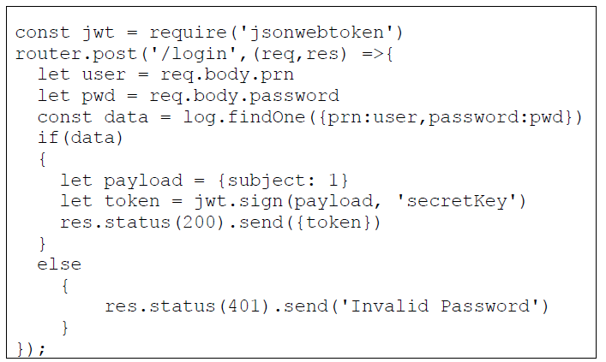
Authentication using JWT(Json Web Token)

Slide 12
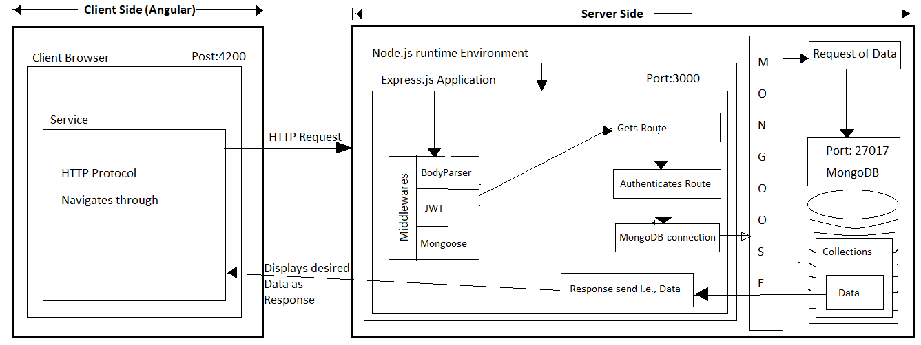
Working of Event Organisation portal using MEAN Stack

Slide 13
Future Use
Using MEAN Stack, we create a mobile application for this website
Adding more features to this site can make the website more convenient.

Slide 14
Conclusion
Web application “Event Organisation” is useful for every institute. With the use of the latest technology MEAN stack development of this web application made it easy. The scalable deployment of the web –services using MEAN stack also eminence further exploration as the technology matures.

Slide 15
References
[1] M. P. S. Mr. Ninaad Nirgudkar, “The mean stack,” International Research Journal of Engineering and Technology (IRJET), vol. 4, 2017.
[2] . Ramappa and D. Bein, “Musiqglobe.fm using mean stack,” 2018 IEEE 8th Annual Computing and Communication Workshop and Conference (CCWC), pp. 661–664, 2018.
[3] A. J. Poulter, S. J. Johnston, and S. J. Cox, “Using the mean stack to implement a restful service for an internet of things application,” 2015 IEEE 2nd World Forum on Internet of Things (WF-IoT), pp. 280–285, 2015.
[4] “Angular documentation.” [Online]. Available: https://angular.io/docs
[5] “Node js documentation.” [Online]. Available: https://nodejs.org/en/docs/
[6] “Express js documentation.” [Online]. Available: https://expressjs.com/
[7] “Mongodb documentation.” [Online]. Available: https://docs.mongodb.com/
[8] K. K. Logesh M, “Mean stack web development,” International Research Journal of Engineering and Technology (IRJET), vol. 7, 2020.
[9] Munawar, Ghifari. (2018)., “Analisa Penerapan MEAN Stack Dalam Pengembangan Web Berbasis Deklaratif.”,9th Industrial Research Workshop
and National Seminar.
[10] Patel, Viral, Daanyaal Kapadia, Deval Ghevariya, and Shiburaj Pappu. ”All India Grievance Redressal App.” Journal of Information Technology
and Digital World 2, no. 2 (2020): 91-99.
[11] Kumar, Dinesh, and Dr S. Smys. ”Enhancing Security Mechanisms for Healthcare Informatics Using Ubiquitous Cloud.” Journal of Ubiquitous Computing and Communication Technologies (UCCT) 2, no. 01 (2020):19-28.
[12] Ityala, Saiteja, Oshin Sharma, and Prasad B. Honnavalli. ”Transparent Watermarking QR Code Authentication for Mobile Banking Applications.” In International Conference on Inventive Computation Technologies, pp. 738-748. Springer, Cham, 2019.

Slide 16
Thank You

